Slide 1
New
AML
Inventory Scanning device Coming SOON!

Slide 2
Congrats on receiving your new inventory scanning devices

Slide 3
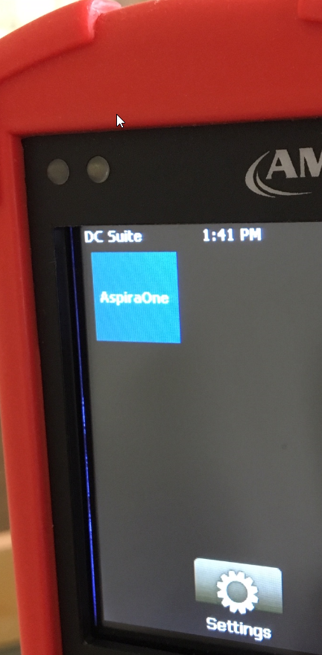
Before Use
Confirm software
Before you can use the AML Inventory Scanning device, confirm the Aspira One Software was installed.
Power on the device by pressing the power button located on the bottom front of the device.
You should see an icon that looks like this:
If you do not see this icon, call Aspira’s help desk @ 888-579-6758 to have the software loaded on the device.

Slide 4
Click this link
Before you can download files from this device, you will need to install software on your DNR computer. (Note: Each time your DNR computer is refreshed you will need to download these again.)
https://aspiraconnect.app.box.com/s/c67g8ktfjbjlxjrseajkbgum9r99fr7t

Slide 5
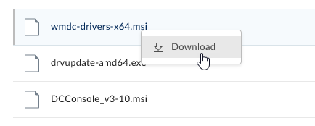
Download the following installers in this order:
wmdc-drivers-x64.msi
drvupdate-amd64.exe
DCConsole_v3-10.msi
Right Click on the name
Then, Click Download

Slide 6

Once your drivers have been installed and you see this icon on your desktop, you’re ready to receive data files.
Reboot your computer.
See document “POS Inventory Reconciliation” for additional instructions

